Slide 1
The Anatomy of Deception:
A Data Analysis of Consumer Fraud & Identity Theft
Presented By: Jennifer Williams (NSS Cohort DA-15)

Slide 2
Agenda
01
Data Source
Suspicious Activity Reports (SARs)
Data Scope & Limitations
02
SARs Data Analysis
Fraud Type Breakdown
Identity Theft Trends
Geographic Insights
Pandemic Impact
03
Conclusion
Key Findings – Summary

Slide 3
Data Source
Data collected from Financial Crimes Enforcement Network (FinCEN)
(FinCEN) collects various "Industry Types" or industry classification codes on Suspicious Activity Reports (SARs) for several critical anti-money laundering (AML) and counter-terrorist financing (CTF) purposes
Suspicious Activity Reports (SAR) established by (5) federal agencies:
Federal Reserve Board
Office of the Comptroller of the Currency
Federal Deposit Insurance Corporation
Office of Thrift Supervision
National Credit Union Administration
Reference: https://www.fincen.gov

Slide 4
Data Source (cont.)
Financial institutions are required to file suspicious activity reports by the authority of the Secretary of the Treasury
Industry Type: Depository Institutions
The largest filer group and has the most varied activity in the following:
Check Fraud
Wire Fraud
Credit/Debit Card Fraud
Mortgage Fraud
Insider Abuse

Slide 5

Notes:
This dashboard identifies the top 5 states with the highest number of SAR filings over the 2014–2024 period. The state with the highest number of SAR filings is California with 2,291,535 SARs. Following California are Ohio (1,445,487 SARs), New York (1,423,928 SARs), North Carolina (1,252,861 SARs), and Texas (1,196,373 SARs).

Slide 6
Notes:
Interestingly, Sussex, DE comes in at #1 with 203,105 SARs, which is significantly higher than the rest of the top 5. The remaining top counties are San Francisco, CA (46,475 SARs), New Castle, DE (40,030 SARs), Los Angeles, CA (18,220 SARs), and Clark county, NV (17,195 SARs). Note if asked: Downloaded the US Census TIGER/Line shapefiles for states and counties

Slide 8
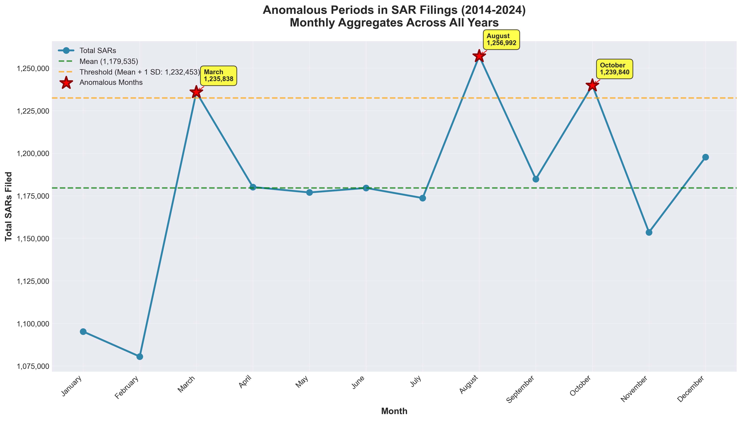
Notes:
This chart shows the total SARs filed by month, aggregated across all years (2014–2024), to identify any anomalous periods. The average number of SARs filed per month is 1,179,535 (the green dashed line). Anomalous months are those where SAR filings exceed the threshold (Mean + 1 SD) of 1,23M (the orange dashed line). The three anomalous months are March (1,235,838 SARs), August (1,266,992 SARs), and October (1,239,840 SARs). No supporting information found to justify the anomaly, however, quarterly and fiscal reporting may be the reason for the anomalous periods: Reporting cycles for financial institutions often end in March, June, September, and December.

Slide 9
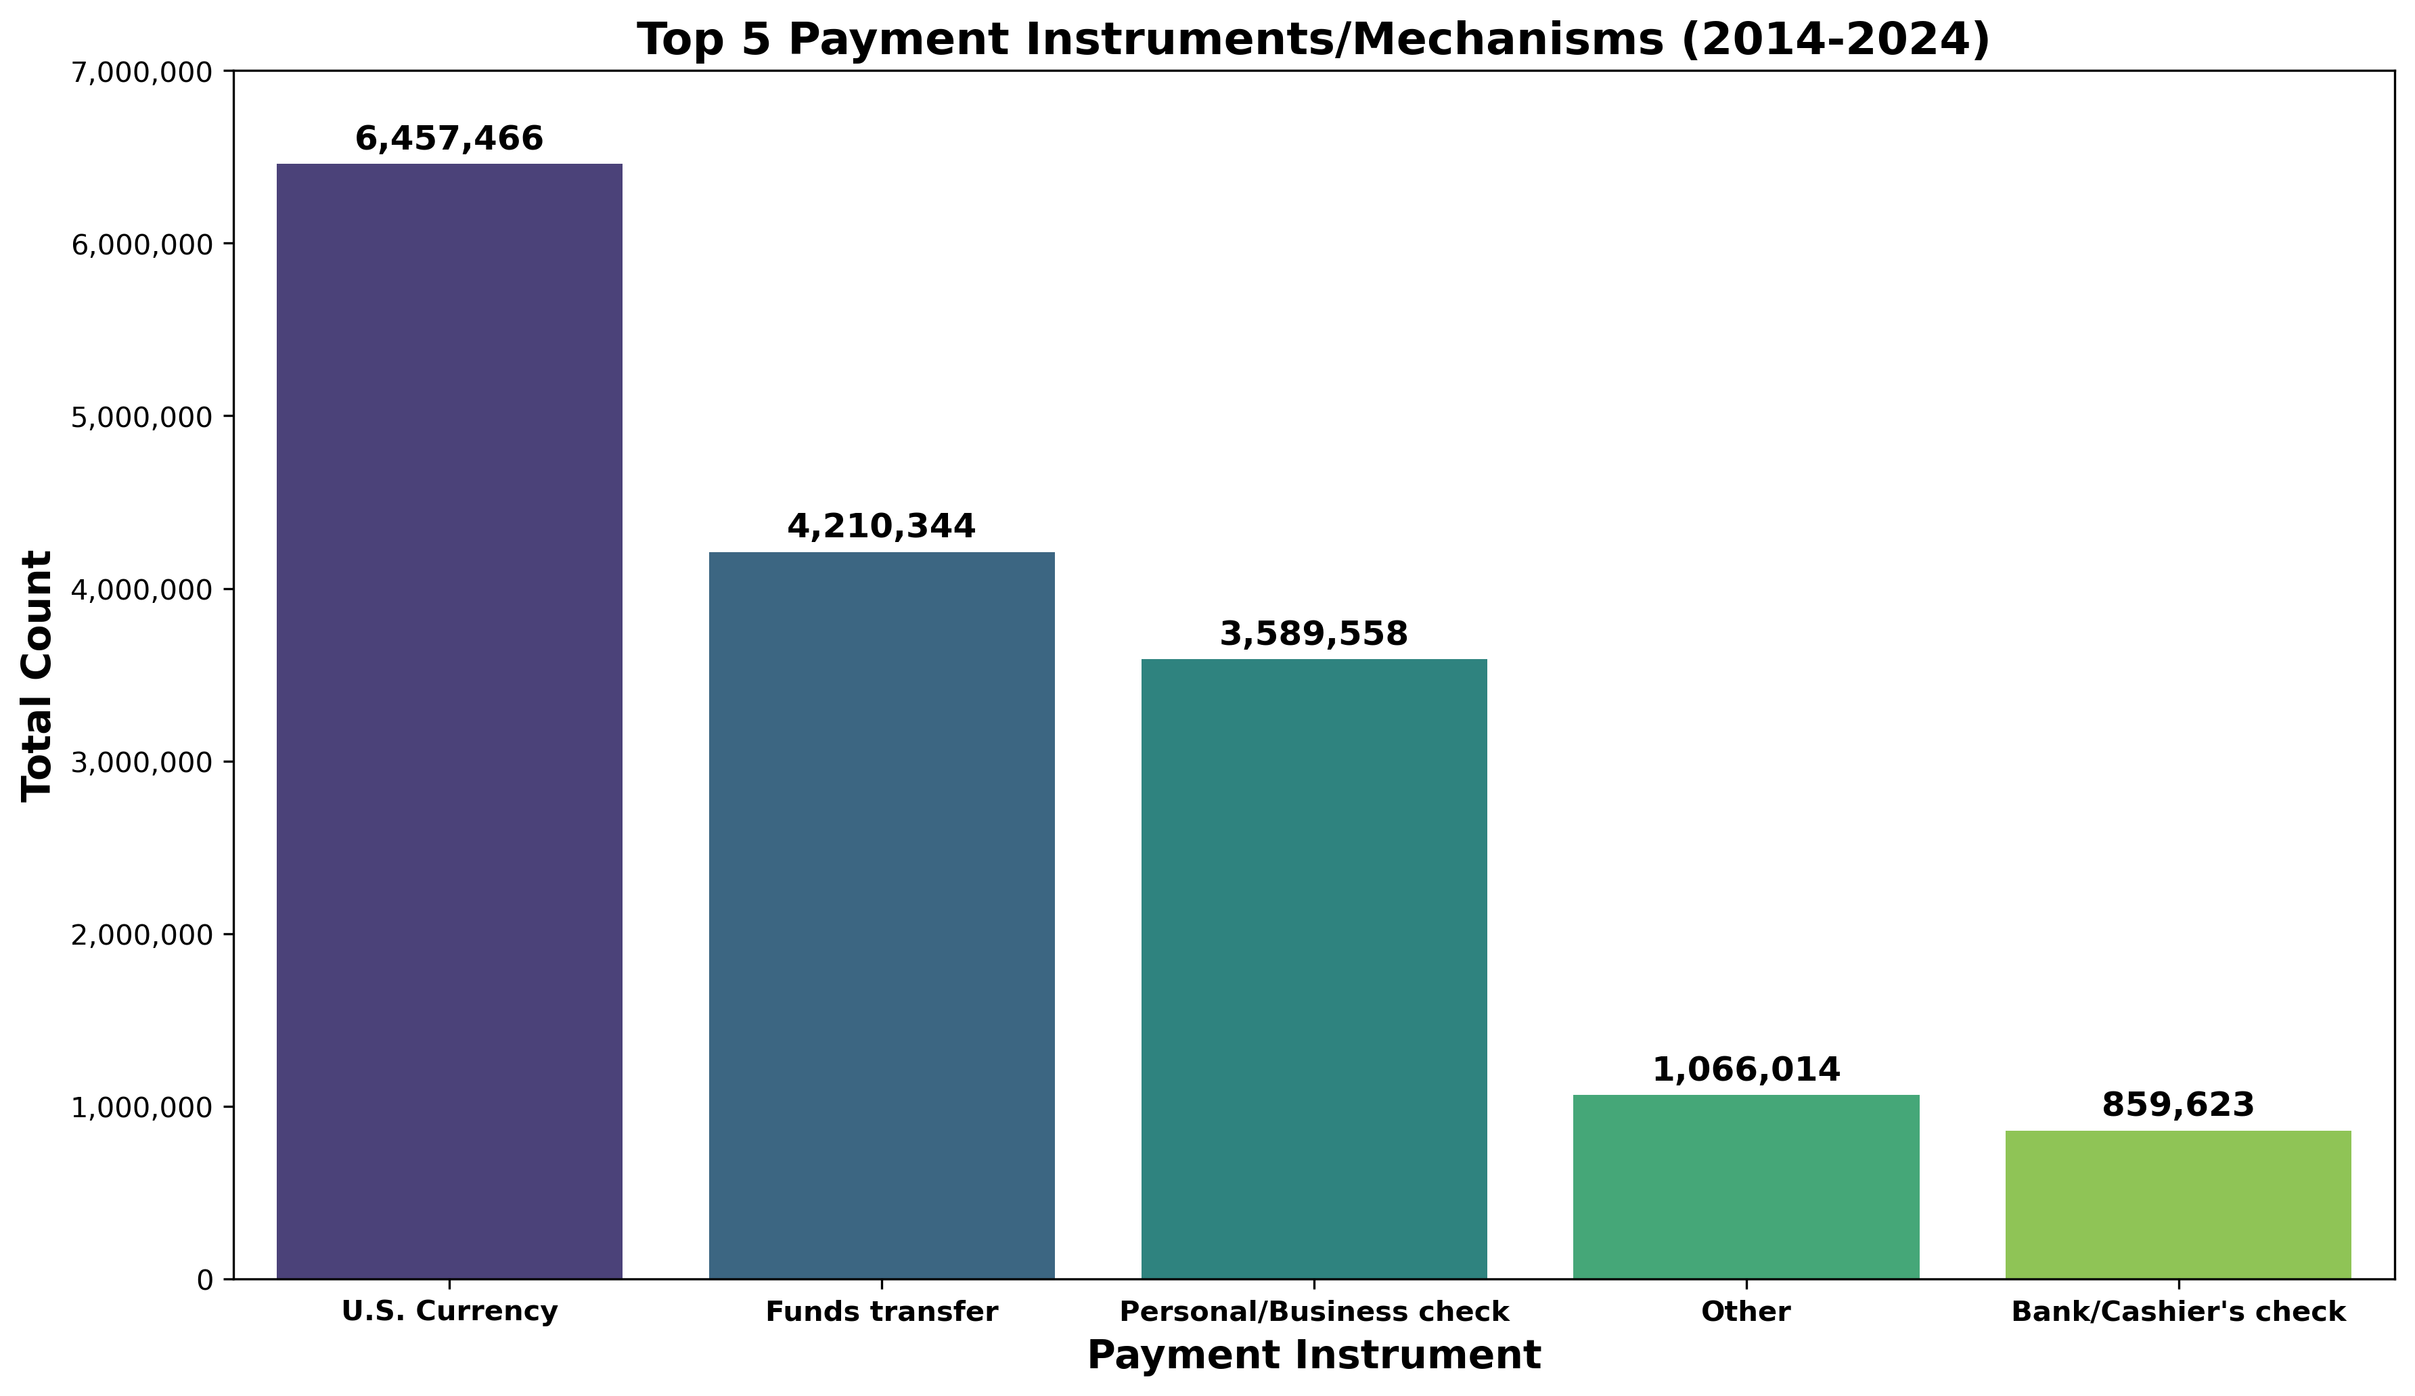
Which payment instruments show the highest growth rate in suspicious activity?

Slide 11
Key Findings – Summary
Top States: California, Ohio, and New York have the highest total number of SAR filings
Top Counties: Sussex, DE has a significantly high number of SAR filings, topping the county list, followed by San Francisco, CA and New Castle, DE
Over 60% of large U.S. corporations and holding companies are headquartered in Delaware
Anomalous Periods: March, August, and October which consistently showed a higher volume of SAR filings than the annual average
May be related to quarterly and fiscal reporting practices
U.S. Currency is the top payment instrument utilized in suspicious activity report filings
Limitations:
State data (2020-2025)
Anti-Money Laundering Act of 2020
Effective Jan 1, 2021
Requires crypto businesses to report geographic location
Enables FinCEN to collect geographic data on suspicious crypto activity
Unable to obtain a list of financial institutions reporting the SAR filings

Slide 12
THANK YOU
A Data Analysis of Consumer Fraud & Identity Theft

